Slide 1
Chapter 9: Virtualization and Cloud Computing
Instructor Materials
IT Essentials 7.0
Notes:
Cisco Networking Academy Program
IT Essentials 7.0
Chapter 9: Virtualization and Cloud Computing

Slide 2
Instructor Materials – Chapter 9 Planning Guide
This PowerPoint deck is divided in two parts:
Instructor Planning Guide
Information to help you become familiar with the chapter
Teaching aids
Instructor Class Presentation
Optional slides that you can use in the classroom
Begins on slide #12
Note: Remove the Planning Guide from this presentation before sharing with anyone.
Notes:
2

Slide 3
Chapter 9: Virtualization and Cloud Computing
IT Essentials 7.0 Planning Guide
Notes:
Cisco Networking Academy Program
IT Essentials 7.0
Chapter 9: Virtualization and Cloud Computing

Slide 4
Check Your Understanding and What Do You Already Know?
Check Your Understanding activities used to be called Interactive Activities. They simply have a new name. They are designed to let students quickly determine if they understand the content and can proceed, or if they need to review.
Check Your Understanding activities do not affect student grades.
Activities listed as What Do You Already Know? are a type of activity in which we ask the student to simply take a guess! It is not meant to evaluate their knowledge. It is only meant to give them a head start in thinking about different topics before they are presented in the course. Students receive addition content in the form of feedback for any answers they select.
What Do You Already Know? activities do not directly affect student grades; however, the feedback may contain content which appears later in quizzes and exams, so it is important that students complete the What Do You Already Know? activities.
There are no separate slides for these activities in the PPT. They are listed in the notes area of the slide that appears before these activities.
Notes:
4

Slide 5
Chapter 9: Activities
What activities are associated with this chapter?
Page # | Activity Type | Activity Name | Optional?
9.1.1.1 | Video Explanation | What is the cloud? | Recommended
9.1.1.6 | Check Your Understanding | Match the Advantages of Virtualization | Recommended
9.1.2.4 | Check Your Understanding | Virtualization Terminology | Recommended
9.1.2.5 | Lab | Install Linux in a Virtual Machine and Explore the GUI | Recommended
9.2.2.2 | What Do You Already Know? | Cloud Models | Recommended
9.2.2.3 | Check Your Understanding | Cloud Service and Cloud Model Technology | Recommended
9.2.2.5 | Check Your Understanding | Match the Cloud Characteristics | Recommended
Notes:
5

Slide 6
Chapter 9: Assessment
Students should complete Chapter 9, “Assessment” after completing Chapter 9.
Quizzes, the lab, and other activities can be used to informally assess student progress.
Notes:
6

Slide 7
Chapter 9: Best Practices
Prior to teaching Chapter 9, the instructor should:
Complete Chapter 9, “Assessment.”
The objectives of this chapter are:
Explain server virtualization.
Install virtualization software on a computer.
Describe uses of the cloud.
Explain characteristics of public, private, hybrid and community cloud computing.
This chapter includes lectures and concepts. Try to include as many questions as possible to keep students engaged during the presentation.
Notes:
7

Slide 8
Chapter 9: Best Practices (Cont.)
Section 9.1.1
Ask the students or have a class discussion
What is the cloud?
How would virtualization help a company?
How has virtualization changed the IT job market?
Do the lab on virtualization and have Linux and Windows or two types of Linux installed in VMs. This is very eye-opening to students.
Demonstrate Hyper-V on a Windows computer.
Since PowerShell scripting is on the certification, you might consider how the following command could be run from the PowerShell console as an administrator: Enable-WindowsOptionalFeature –Online –FeatureName Microsoft-Hyper-V –All
Don’t forget to reboot the computer after the command has been executed.
Notes:
8

Slide 9
Chapter 9: Best Practices (Cont.)
Section 9.2.1
Ask the students or have a class discussion
What are examples of cloud services we use daily?
Do a demonstration with a cloud service such as OneDrive, GoogleDrive, SugerSync, and DropBox.
Have the students demonstrate what cloud services they may use.
Talk about gaming and the effects of that industry on the cloud. Ask if any of the students have played Minecraft or another multi-player game. Ask them where the code for that game resides when friends play online.
Get the students to research apps that companies would use to collaborate on a project or brainstorm ideas.
Share what the apps do
Share how cloud-based apps have changed collaboration (people can contribute when they are available instead of everyone having to be in a physical room at the same time)
Notes:
9

Slide 10
Chapter 9: Best Practices (Cont.)
Demonstrate a school provided collaboration tool through the school’s learning management system (LMS) or app.
Discuss where the server might be located – in a network closet, network operations center, rented space with the school providing the server, or cloud service located somewhere in the world.
Discuss how the tool may be a VM sharing the same server that provides email.
Notes:
10

Slide 11
Chapter 9: Additional Help
For additional help with teaching strategies, including lesson plans, analogies for difficult concepts, and discussion topics, visit the ITE Community at: https://community.cisco.com/t5/networking-academy/ct-p/Netacad, or simply go to https://community.cisco.com
If you have lesson plans or resources that you would like to share, upload them to the ITE Community in order to help other instructors.
Notes:
11

Slide 12
Chapter 9: Virtualization and Cloud Computing
IT Essentials 7.0
Notes:
Cisco Networking Academy Program
IT Essentials 7.0
Chapter 9: Virtualization and Cloud Computing

Slide 13
Chapter 9 - Sections & Objectives
9.1 Virtualization
Install a virtual machine on a computer.
Explain server virtualization.
Install virtualization software on a computer.
9.2 Cloud Computing
Compare cloud computing concepts.
Describe the uses of the cloud.
Explain characteristics of public, private, hybrid and community cloud computing.
Notes:
13
Cisco Networking Academy Program
IT Essentials 7.0
Chapter 9: Virtualization and Cloud Computing

Slide 14
9.1 Virtualization
Notes:
9 – Virtualization and Cloud Computing
9.1 – Virtualization

Slide 15
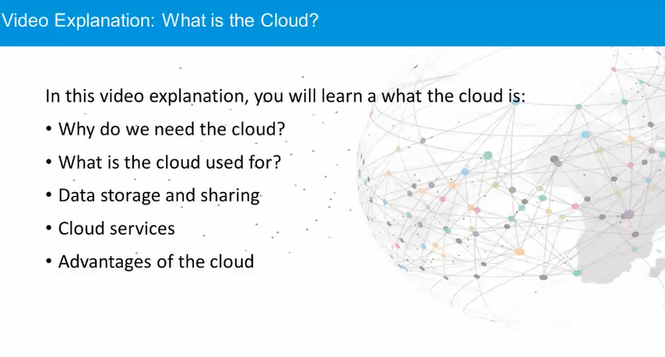
Video Explanation – What is the cloud?
Notes:
9 – Virtualization and Cloud Computing
9.1 – Virtualization
9.1.1 – Virtualization
9.1.1.1 – Video Explanation - What is the cloud?

Slide 16

Virtualization Cloud Computing and Virtualization
Virtualization enables a single computer to host multiple independent virtual computers called virtual machines (VM) that share the host computer hardware.
Virtualization software separates the actual physical hardware from the VM instances.
An image of a VM can be saved as a file and then be re-started when required.
Cloud computing separates the applications from the hardware.
Service providers such as Amazon Web Services (AWS) own and manage the cloud infrastructure.
Virtualization is the foundation which supports cloud computing.
Notes:
9 – Virtualization and Cloud Computing
9.1 – Virtualization
9.1.1 – Virtualization
9.1.1.2 – Cloud Computing and Virtualization

Slide 17
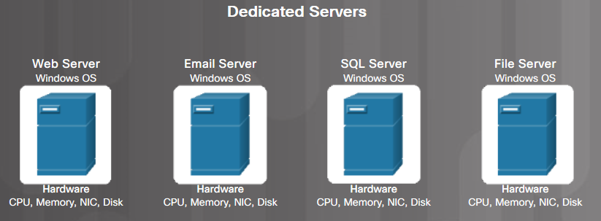
Virtualization Traditional Server Deployment
Traditionally, organizations delivered applications and services using powerful dedicated servers.
These dedicated servers are equipped with large amounts of RAM, powerful CPUs, and multiple large storage devices.
Disadvantages include: wasted resources, single-point of failure, and server sprawl.
Notes:
9 – Virtualization and Cloud Computing
9.1 – Virtualization
9.1.1 – Virtualization
9.1.1.3 – Traditional Server Deployment

Slide 18
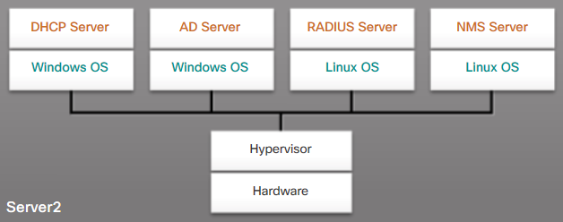
Virtualization Server Virtualization
Server virtualization takes advantage of idle resources to reduce the number of servers required.
A program called the hypervisor is used to manage the computer resources and various VMs.
It provides VMs access to the hardware in the physical machine such as CPUs, memory, disk controllers, and NICs.
Each VM runs a complete and separate operating system.
Notes:
9 – Virtualization and Cloud Computing
9.1 – Virtualization
9.1.1 – Virtualization
9.1.1.4 – Server Virtualization

Slide 19
Virtualization Advantages of Server Virtualization
Better use of resources
Less space required
Less energy consumed
Reduced cost
Faster server provisioning
Maximize server uptime
Improved disaster recovery
Support for legacy systems
Notes:
9 – Virtualization and Cloud Computing
9.1 – Virtualization
9.1.1 – Virtualization
9.1.1.5 – Advantages of Server Virtualization
9.1.1.6 – Check Your Understanding-Match the Advantages of Virtualization

Slide 20
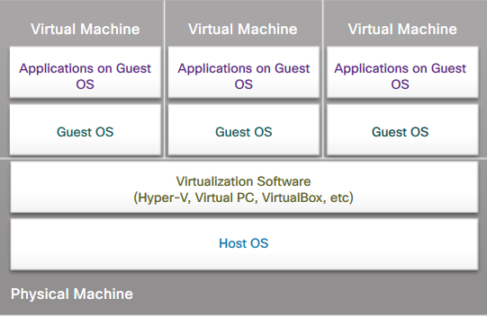
Virtualization Client-Side Virtualization
Client-side virtualization enables users to run VMs on their local computer.
It allows users to test new operating systems, software, or to run older software.
Host computer – the physical computer controlled by a user.
Host OS - the operating system of the host computer.
Guest OS - the operating system that is running in the VM.
Notes:
9 – Virtualization and Cloud Computing
9.1 – Virtualization
9.1.2 – Client-Side Virtualization
9.1.2.1 – Client-Side Virtualization

Slide 21
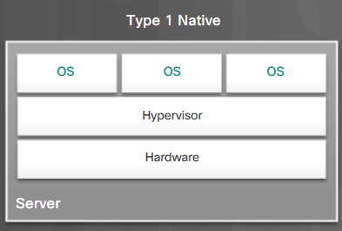
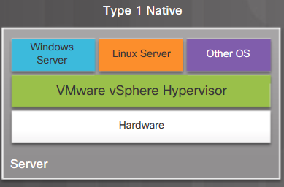
Virtualization Type 1 and Type 2 Hypervisors
Type 1 (native) hypervisor is typically used with server virtualization. For example, they are used in data centers and cloud computing.
Type 1 hypervisors run directly on the hardware of a host, and manage the allocation of system resources to VMs.
Type 1 hypervisors include VMware vSphere / ESXi, Xen, and Oracle VM Server.
Notes:
9 – Virtualization and Cloud Computing
9.1 – Virtualization
9.1.2 – Client-Side Virtualization
9.1.2.2 – Type 1 and Type 2 Hypervisors

Slide 22
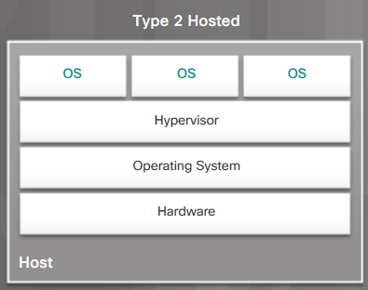
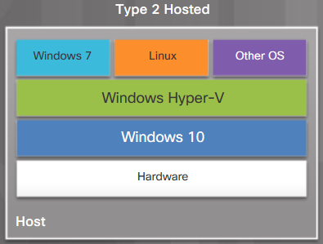
Virtualization Type 1 and Type 2 Hypervisors (Cont.)
Type 2 (hosted) hypervisors are commonly used with client-side virtualization.
Type 2 hypervisors work with the host computer to create and use multiple VMs.
Type 2 hypervisors include VMware Workstation, Windows Hyper-V, and Oracle VirtualBox.
Notes:
9 – Virtualization and Cloud Computing
9.1 – Virtualization
9.1.2 – Client-Side Virtualization
9.1.2.2 – Type 1 and Type 2 Hypervisors (Cont.)

Slide 23
Virtualization Virtual Machine Requirements
Windows Hyper-V Minimum Requirements for Windows 10
Host OS | Windows 10 Pro or Windows Server (2012 and 2016)
Processor | 64-bit CPU with Second Level Address Translation (SLAT)
BIOS | CPU support for VM Monitor Mode Extension (VT-c on Intel CPUs)
Memory | Minimum 4GB system RAM
Hard Disk Space | At least 15GB per VM
Hyper-V is included in Windows 10 Pro
Notes:
9 – Virtualization and Cloud Computing
9.1 – Virtualization
9.1.2 – Client-Side Virtualization
9.1.2.3 – Virtual Machine Requirements

Slide 24
Virtualization Virtual Machine Requirements (Cont.)
Windows Hyper-V Minimum Requirements for Windows 8
Host OS | Windows 8 Pro or Enterprise 64-bit OS
Processor | 64-bit CPU with Second Level Address Translation (SLAT)
BIOS | BIOS-level Hardware Virtualization support
Memory | Minimum 4GB system RAM
Hard Disk Space | At least 15GB per Virtual OS
Notes:
9 – Virtualization and Cloud Computing
9.1 – Virtualization
9.1.2 – Client-Side Virtualization
9.1.2.3 – Virtual Machine Requirements (Cont.)

Slide 25
Virtualization Virtual Machine Requirements (Cont.)
Windows Virtual PC Requirements in Windows 7
Processor | 1 GHz 32-bit or 64-bit Processor
Memory | 2GB
Hard Disk Space | At least 15 GB per Virtual OS
Notes:
9 – Virtualization and Cloud Computing
9.1 – Virtualization
9.1.2 – Client-Side Virtualization
9.1.2.3 – Virtual Machine Requirements (Cont.)
9.1.2.4 – Check Your Understanding - Virtualization Terminology

Slide 26
Virtualization Lab – Install Linux in a Virtual Machine and Explore the GUI
In this lab, you will install a Linux OS in a virtual machine using a desktop virtualization application, such as VirtualBox. After completing the installation, you will explore the GUI interface.
Objectives:
Part 1: Prepare a Computer for Virtualization
Part 2: Install a Linux OS on the Virtual Machine
Part 3: Explore the GUI
Notes:
9 – Virtualization and Cloud Computing
9.1 – Virtualization
9.1.2 – Client-Side Virtualization
9.1.2.5 – Lab - Install Linux in a Virtual Machine and Explore the GUI

Slide 27
9.2 Cloud Computing
Notes:
9 – Virtualization and Cloud Computing
9.2 – Cloud Computing

Slide 28
Cloud Computing How We Use the Cloud
Place holder
Notes:
9 – Virtualization and Cloud Computing
9.2 – Cloud Computing
9.2.1 – Cloud Computing Applications
9.2.1.1 – How We Use the Cloud

Slide 29
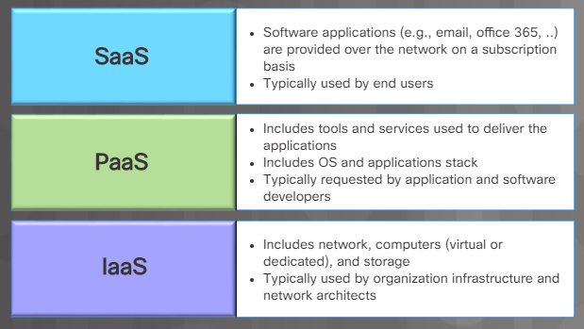
Cloud Computing Cloud Services
Cloud service providers can provide various services tailored to meet customer requirements.
Software as a Service (SaaS)
Platform as a Service (PaaS)
Infrastructure as a Service (IaaS)
Cloud service providers have extended the IaaS model to also provide IT as a service (ITaaS).
Notes:
9 – Virtualization and Cloud Computing
9.2 – Cloud Computing
9.2.2 – Cloud Services
9.2.2.1 – Cloud Services
9.2.2.2 – What Do You Already Know? - Cloud Models
9.2.2.3 – Check Your Understanding - Cloud Services and Cloud Model Terminology

Slide 30
Cloud Computing Cloud Computing Characteristics
On-demand (self-service)
Rapid elasticity
Resource pooling
Measured and metered service
Broad network access
Notes:
9 – Virtualization and Cloud Computing
9.2 – Cloud Computing
9.2.2 – Cloud Services
9.2.2.4 – Cloud Computing Characteristics
9.2.2.5 – Check Your Understanding - Match the Cloud Characteristics

Slide 31
9.3 Chapter Summary
Notes:
9 – Virtualization and Cloud Computing
9.3 – Summary

Slide 32
Conclusion Chapter 9: Virtualization and Cloud Computing
Explain server virtualization.
Install virtualization software on a computer.
Describe uses of the cloud.
Explain characteristics of public, private, hybrid and community cloud computing.
Notes:
1.5 – Summary
1.5.1 – Conclusion

Slide 33
Chapter 9 New Terms and Commands
Computer virtualization Virtual machine (VM) Cloud computing Hypervisor Server virtualization Client-virtualization Host computer Host operating system Guest operating system (guest OS) Type 1 hypervisor Type 2 hypervisor | Software as a Service (SaaS) Platform as a Service (PaaS) Infrastructure as a Service (IaaS) IT as a service (ITaaS) Private cloud Community cloud Public cloud Hybrid cloud On-demand (self-service) Rapid elasticity Resource pooling
Notes:
New Terms and Commands

